Slide 1
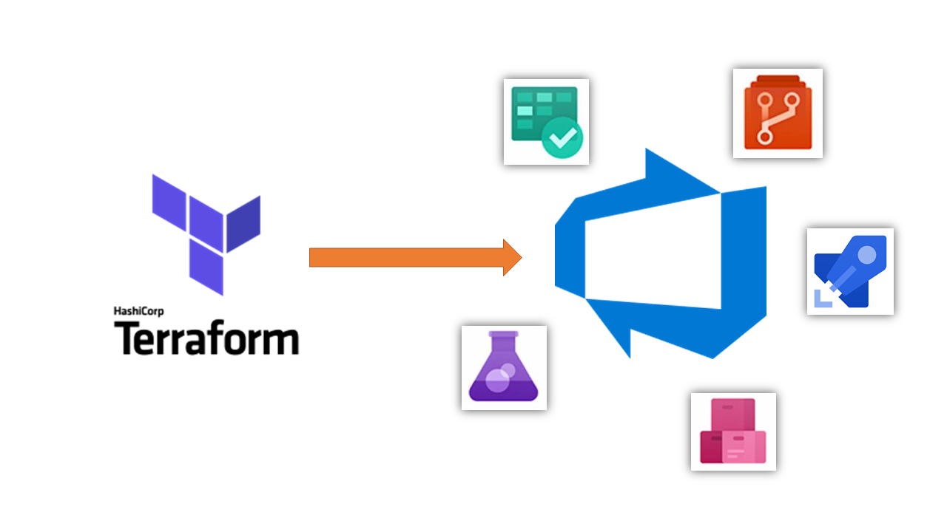
Terraform workshop
Objective: Creating terraform and Azure DevOps integration

Slide 2
Step1: Prework
Assuming you have-
Killerkoda account with azure cli authentication
Service connection
Repository that container terraform main.tf

Slide 3
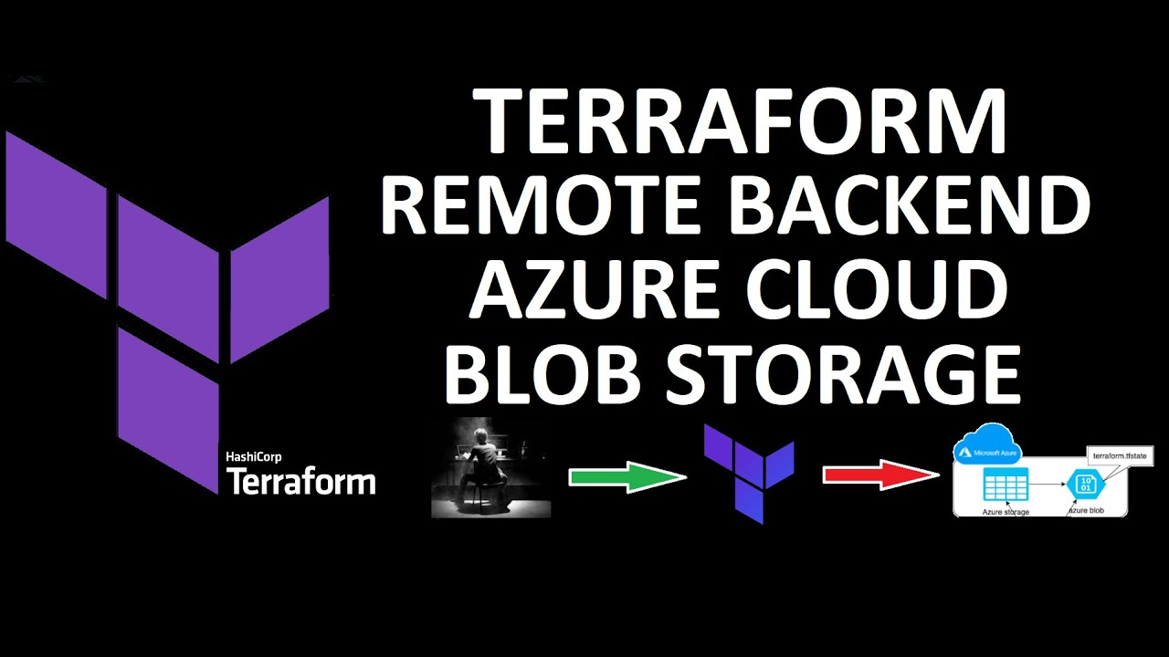
Step2: Terraform backend configuration

Slide 4
Step3- Create configuration
Create main.tf and pipeline.yaml

Slide 5
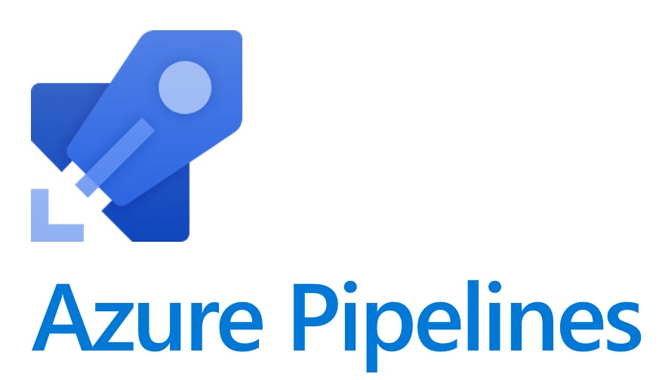
Step4- Run the pipeline

